Slide 1
Smart Geo-fencing with Location Sensitive Product Affinity
Ankur Garg | Sunav Choudhary | Payal Bajaj
Adobe Research | Adobe Research | Stanford University
Sweta Agrawal | Abhishek Kedia | Shubham Agrawal
Adobe | Adobe | Adobe
Notes:
Good Morning Everyone!

Slide 2

What is Geo-fencing?
Geo-fencing:
Send messages at entry/exit in an area
Consist of two broad stages:
Geo-fence design:
Real time detection:
Entry
Exit
OUR FOCUS
Most of prior work in geo-fencing
Example Geo-fence
Notes:
This work is about geo-fencing which is a popular location based marketing technique. In the industry, it allows marketers to push offers at entry/exit in a certain area termed as geo-fence.
Process of geo-fencing has two phases:
First, the geo-fences have to be designed. If you see the graphic on the right, this will correspond to selecting the location and radius of the geo-fence.
Then comes the real time detection stage where we need to detect in real time whether a user has entered or exited a geo-fence and trigger the corresponding message. Most of the prior work has focused on efficient solutions for deployment while our work focuses on the design stage.

Slide 3
Motivation
Manual process
Perform data analysis
Decide the radius and location of geo-fence
Lack personalization aspect
Risk of User Attrition – Highly undesirable
Small Geo-fence,
Misses customers
Large Geo-fence,
User Attrition
Notes:
The motivation to focus on geo-fence design stage comes from the fact that the current process are highly manual. Marketers perform data analysis to infer user interests and then decide the radius and location of the geo-fence.
This leads to design of very small geo-fences which can miss out many potential customers. Conversely, the marketer may designate a large area as a geo-fence and target everybody that dilutes the personalization aspect and runs the risk of user attrition.
Thus, we want to tie the data analysis and geo-fence design process together to prevent such situations.

Slide 4
Nature of Dataset
Data from aggregated E-Commerce retailers’ mobile apps
Range of products arranged in multi-level hierarchy.
3 level hierarchy for products
User id | Category | Subcategory | Product Type | Latitude | Longitude | Time
U1 | Men Clothing | Shirts | Brand X’s shirt | lat1 | long1 | 21:29
U1 | Beverages | Juices | Orange Juice | lat2 | long2 | 11:59
U2 | Shoes | Sport Shoes | Brand Y’s shoes | lat3 | long3 | 14:25
Notes:
Before moving on, here is description of the dataset that we used. We used usage logs pertaining to browsing activity for products aggregated from multiple E-commerce retailers’ mobile apps.
All the products are arranged in a 3 level hierarchy and additionally, location is also recorded in the form of GPS
coordinates(<latitude, longitude> tuple).

Slide 5
Location Sensitive Product Affinity
Capture’s User Interest in product
Varies with Location
High Affinity for Product p in this area
Low Affinity for Product p
User Activity for Product p in a large area

Slide 6
Goal
An automated approach to design smart geo-fences based on location sensitive product affinity for users
Notes:
The motivation to focus on geo-fence design stage comes from the fact that the current process are highly manual. Marketers perform data analysis to infer user interests and then decide the radius and location of the geo-fence.
As a result, only global patterns can be inferred and this lack of personalization can lead to excessive targeting which might lead to user attrition. This is highly undesirable.
So, we propose an automated approach to design smart geo-fences based on location dependent user affinity

Slide 7
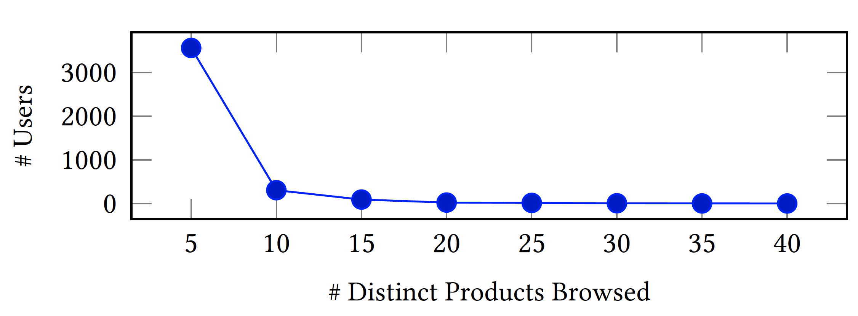
Challenges
Sparsity of data
Users browse a small number of products
Users visits a small number of locations
Users X Product X Location: extremely sparse matrix
No. Of Locations | No. of Users
<10 | 3966
10-25 | 29
>25 | 5
Notes:
The main challenge in doing this work was the extreme sparsity. One one hand you see users only browse 5-10 products on an average in e-commerce apps, while on the other they visit very few locations as compared to the large area like a city.

Slide 8
Contributions
An end-to-end system for automated design of affinity based smart geo-fences:
Product specific and personalized for user segments
Number and sizes of geo-fence created are alterable => Good Scalability
Modeling latent location sensitivity in user’s affinity
Mitigating the extreme sparsity problem
Notes:
We make 3 major contributions through this work. First, we provide an end-to-end system for automated geo-fence design based on affinity. These geo-fences are product specific and personalized for user segments. It is also possible to vary the number and size of geo-fences as per requirements and thus, our method is highly scalable.
To design geo-fences, we model user’s affinity towards a product and this is sensitive to the location of the user.
Finally, our approach mitigates the extreme sparsity through a three step affinity modeling approach.

Slide 9
Preprocessing: Stay Point Detection
Li, Quannan et al.^{[1]} introduce the concept of stay points:
Represent all location points by a single point within:
A distance threshold (100m),
Time Threshold (5 mins)
Source: Mining user similarity based on location history^{[1]}
Notes:
The number of location coordinates in such kind of datasets tends to increase very rapidly which carry little semantic meaning. Thus, we use the work of Li et al. to preprocess all the location coordinates into corresponding stay points. A stay point represents all location coordinates of single user that lie within a distance threshold and visited inside a fixed time interval. All future references of location pertain to the stay point they lie in.

Slide 10
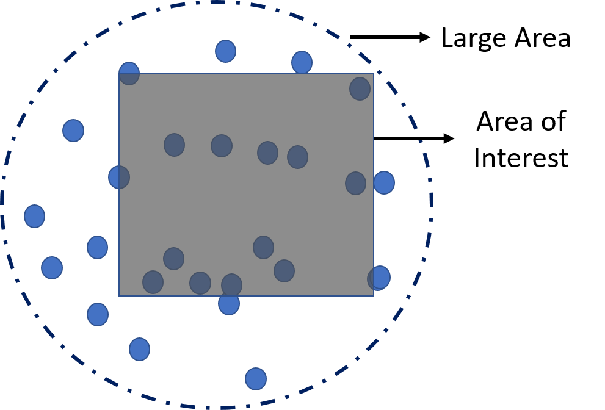
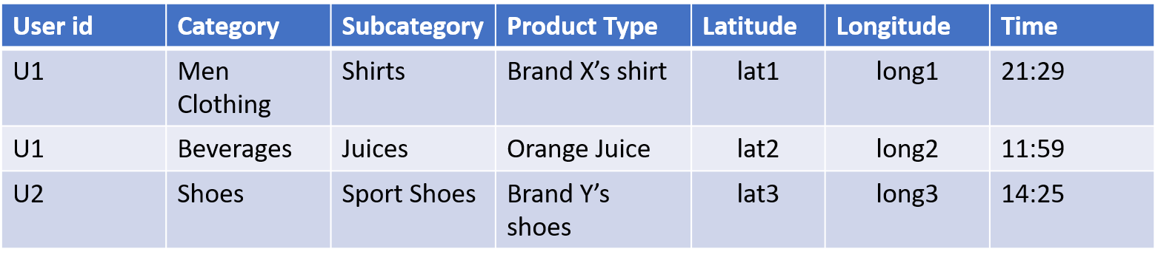
Solution Architecture
Input:
Notes:
Let’s now look at our solution architecture. The input for our work is the usage log from mobile apps that consist of activity within a large area. Then, we need the area of interest inside this large area which is where the marketer desires to design geo-fences.

Slide 11
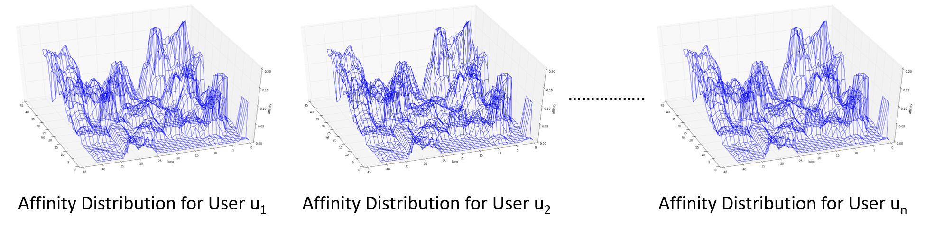
Solution Architecture
Input:
Affinity Modeling:
Notes:
Then comes the affinity modeling stage. Here, we first divide the area of interest into small grid squares and aim to an affinity distribution for all users over this area.

Slide 12



Solution Architecture
Input:
Affinity Modeling:
Geo-Fence Design:
Notes:
We move on to the geo-fence design stage where we first find user segments based on similarity in affinity distributions. Then, the geo-fences are designed for each of these user segments. These personalized geo-fences for user segments are the outputs of our approach.

Slide 13
Solution Architecture
Input:
Affinity Modeling:
Geo-Fence Design:
Output:

Slide 14
Affinity Modeling
Dimensions: Products, User, and Location
Three step approach to counter sparsity
Product based Affinity
Semantic Location based Affinity
User based Affinity
Notes:
Now let’s delve deeper into affinity modeling
There are three entities in the system: the products that the retailers offer, the users and the locations visited by them. Our model computes intra-entity similarities and then estimates affinity in a three step approach as shown in the graphic. Let’s go through each of them in detail. First up, is product-product similarity based affinity.

Slide 15
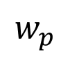
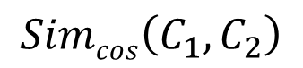
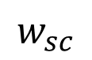
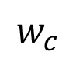
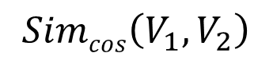
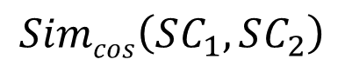
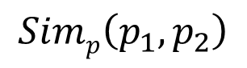
Product Similarity
Category
 | C₁ | C₂ | C₃
U₁
U₂
U₃
Cosine Similarity
$$Simcos\left(C_{1},C_{2}\right)$$
$$w_{c}$$
 | p₁ | p₂ | p₃
U₁ | 0.4 | 0.5 | 0.1
U₂ | 0.6 | 0.2 | 0.2
U₃ | 0.0 | 0.7 | 0.3
Sub-category
 | SC₁ | SC₂ | SC₃
U₁
U₂
U₃
Cosine Similarity
$$w_{sc}$$
$$Simp\left(p_{1},p_{2}\right)$$
$$Simcos\left(SC_{1},SC_{2}\right)$$
User Product Matrix
Product Type
$$w_{p}$$
 | V₁ | V₂ | V₃
U₁
U₂
U₃
Cosine Similarity
$$Simcos\left(V_{1},V_{2}\right)$$
Notes:
We use a hybrid notion of product similarity based on both the usage data and the hierarchical information for products. Consider two product p1 and p2 in the user-product matrix where each cell represents the normalized browse counts by user for a product. Using the hierarchical information we can similar matrices for the category, sub-category and the vertical of the product. Cosine similarity between corresponding categories, sub-categories and verticals of p1 and p2 can be computed to get three similarity values. Weighted average is taken that represents the similarity between p1 and p2.

Slide 16
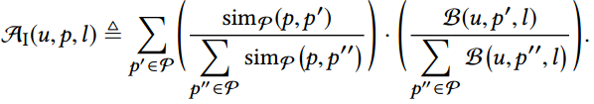
Product based Affinity
Similar Products can have similar affinity at same location
Normalized product
similarity
Normalized product
browse counts
Affinity for (u,p’,l) -> Affinity for (u,p,l)
Notes:
We then compute the product-product similarity based affinity where use the fact that similar products can have similar affinity at same locations. As you can see, the formulation allows us to estimate affinity for a product p using p’ even though it might not have been actually browsed at that location.

Slide 17
Affinity Modeling
Product based Affinity
Semantic Location based Affinity
User based Affinity
Notes:
We then move on to user-user similarity based affinity

Slide 18
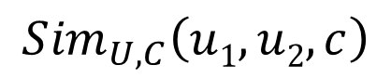
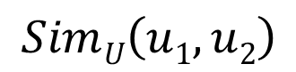
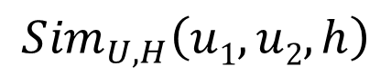
User Similarity
Cluster stay points of all users^{[1]}
Stay Points of User u₁
Compute Similarity in each cluster
Stay Points of User u₂
Aggregate similarities at a layer
Sum across all levels
$$SimU\left(u1, u2\right)$$
$${Sim}_{U,C}\left(u1, u2, c\right)$$
$${Sim}_{U,H}\left(u1, u2, h\right)$$
Notes:
The computation of user similarity between two user through a series of steps. We first hierarchically cluster the stay points of all users. I have depicted only two users u1 and u2 in the graphic for simplicity. Then we compute the similarity between products viewed by the two users at stay points in a common cluster. This is aggregated to find similarity at a given level in the cluster hierarchy. Finally, this is added across all levels to get the final similarity between u1 and u2.

Slide 19
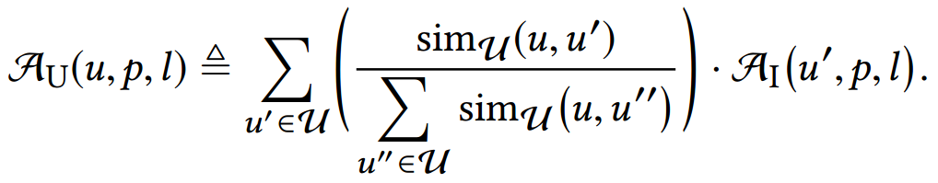
User based Affinity
Reinforce with affinity of similar users
Normalized user-user similarity
Product based Affinity
Affinity for (u’,p,l) -> Affinity for (u,p,l)
Notes:
We use this similarity and the affinity computed in the previous step to compute the user-user similarity based affinity. Note that this helps to estimate affinity for user u at a location where he has never browsed using the affinity of u’ at the same location. Thus, reducing some of the sparsity.

Slide 20
Affinity Modeling
Product based Affinity
Semantic Location based Affinity
User based Affinity
Notes:
Finally, comes the Semantic Location-Location based affinity.

Slide 21
Semantic Location Similarity
Actual Vector: More than 100 types of places
Cosine Similarity for computing similarity
Semantics of Location 1
Semantics of Location 2
Restaurants | Church | Gym | Banks
0.6 | 0.1 | 0.3 | 0.0
Restaurants | Church | Gym | Banks
0.6 | 0.2 | 0.0 | 0.2
$$simL\left(l1, l2\right)$$
Notes:
Location semantics capture the types of places in a small around a given location in the form of a vector. A sample of semantic vector is shown for two locations here and we use standard cosine similarity to get similarity between location l1 and l2.

Slide 22
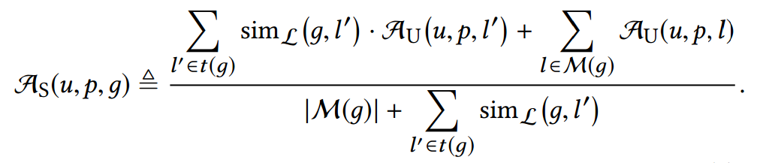
Semantic Location based Similarity
User based Affinity from locations outside area of interest
Locations inside grid
Affinity for (u,p,l’) -> Affinity for (u,p,g)
Notes:
This similarity is used for estimating affinity at locations inside the grid where there is no user activity at all. This is done using the affinities from semantically similar locations outside the area of interest which also helps in generalizing our model.

Slide 23
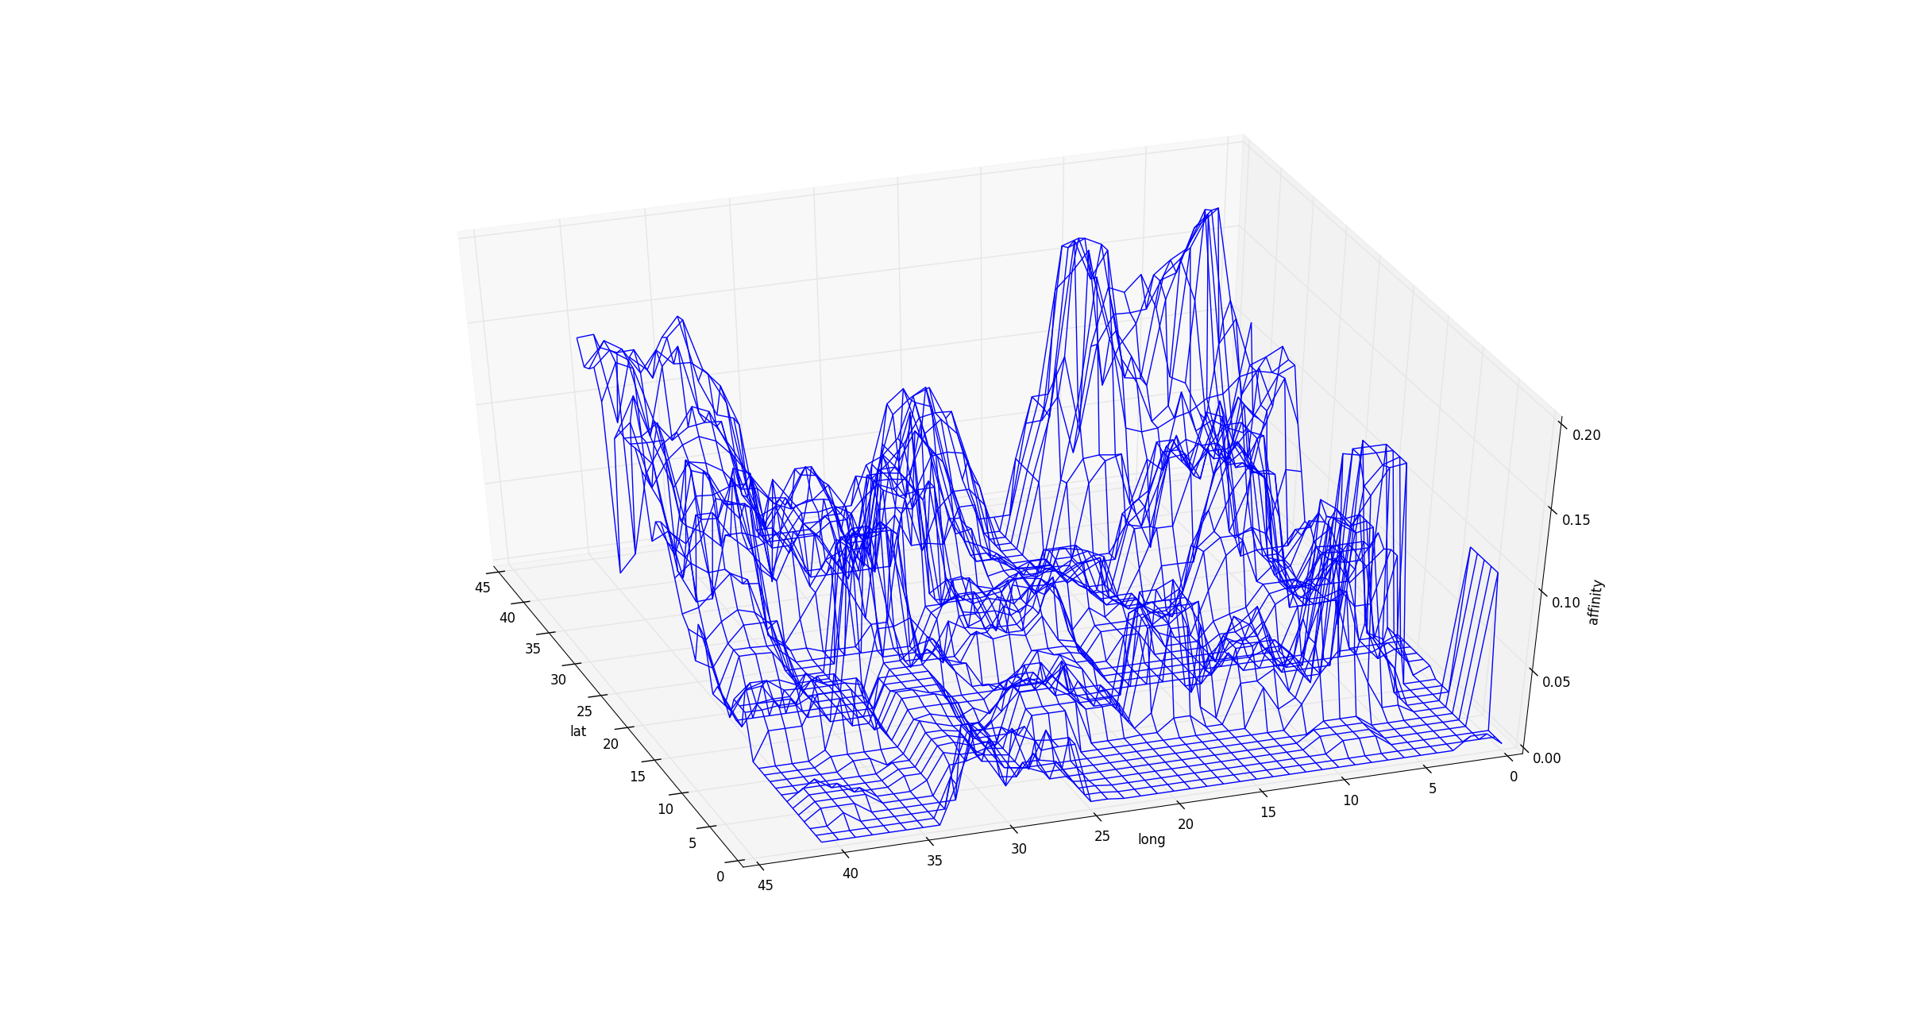
Geo-fence Design (1): User Segmentation
Reduces the number of geo-targeting areas needed
Number of segments : Calinski-Harabasz (CH) value vs k
Affinity Distribution for User 1
.
.
.
.
.
.
Affinity Distribution for User n
K Means Clustering
Notes:
Once these affinity distributions are created, we move to user segmentation. Creating separate geo-fences for each user will be an arduous task to manage. Thus, users with similar distribution over space are grouped into segments using K-means clustering. The the number of segments, that is k, is decided using the CH value which measures the quality of clustering output.

Slide 24
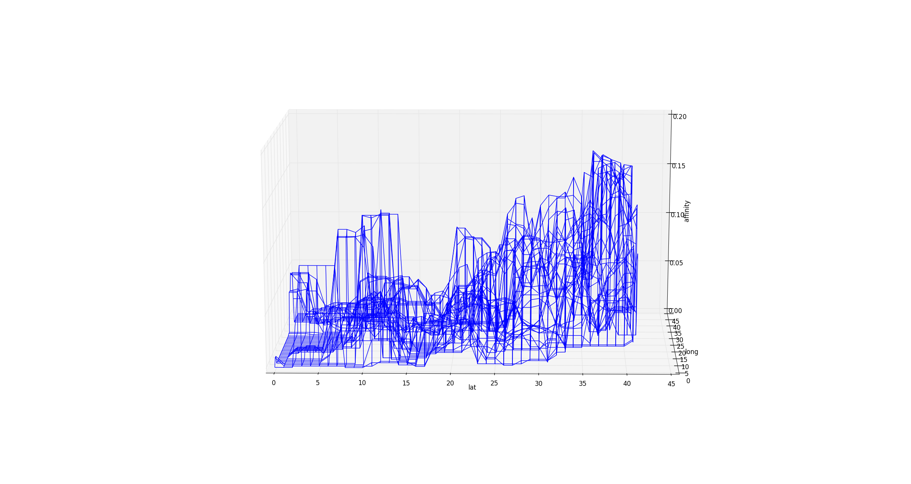
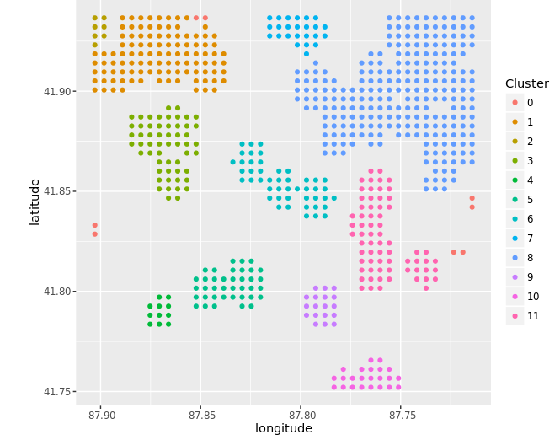
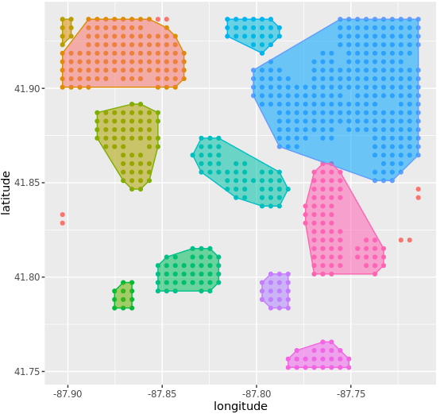
Geo-fence design (3): Boundary Creation
Alpha Hulls for creating tight boundaries
Average Distribution plot
Spatial clustering(DBSCAN)
Alpha hull to create geo-fences
Notes:
Coming to final task of our workflow,i.e. geofence creation.
Once we have our segments, average distribution for these segments is calculated to represent a user segment. Then we select a threshold and all the points with affinity value above the threshold in the average distribution graph are selected. Spatial clustering using DBSCAN is performed to collect nearby grid squares into decent sized areas. Finally, boundary construction algorithm like alpha hull is employed to create boundaries around these nearby grid squares.

Slide 25
Dataset Description
15 days of usage logs of e-commerce mobile apps
Dataset used for designing geo-fences:
First 10 days of usage logs
About 4000 users and 500 products
Number of browses: 40,000
Area of Interest: 20 km X 20 km square area
Testing Dataset:
Last 5 days of usage logs
800 users in common with training set
5 products had geo-fence based offers
Notes:
These are the details of the dataset that we used for experiments. We had 15 days of usage logs which out of which the first 10 days were used as train and the remaining were used as test. The trainset consisted of about 40k browsing transactions on 500 products for about 4000 users. The area of interest was taken as 20X20 km area in the center of a city. The test set contained about 800 users in common with trainset and had geo-fence based offers for 5 different products.

Slide 26
Validation Strategy
Area of Interest
True Positive: Browsed the product when inside geo-fence.
False Positive: Did not browse the product
False Negative: Browsed the product but outside of geo-fence
Geo-fences for a user segment for a given product
Notes:
We use the standard metrics of precision, recall and F1-score for validation. Consider the area of interest and the two circles in it as geo-fences designed by our approach. If a user browsed the product inside the geo-fence, it is taken as a true positive. If he did not browse the product at all, it is considered as false positive. Lastly, if the product was browsed outside the geo-fence it is counted as a false negative.

Slide 27
Comparison with Baselines (1)
Geo-fences designed by domain experts (DEG)
Small Number of users targeted -> Low Recall
Method | Precision (%) | Recall (%) | F1-Score (%)
LSPAG (Our Method) | 18.32 | 38.80 | 24.89
DEG | 10.00 | 1.00 | 1.81
Notes:
First, we compared our method with manually created geo-fences annotated in the dataset. You can see here that this method gets a low recall as it targets in very small areas and misses out on many potential customers.

Slide 28
Comparison with Baselines (2)
Unable to infer semantically similar location behavior
Validates use of three-step affinity model
Method | Precision (%) | Recall (%) | F1-Score (%)
LSPAG (Our Method) | 18.32 | 38.80 | 24.89
K-Nearest Neighbor | 1.55 | 2.05 | 1.77
Matrix Factorization | 15.07 | 22.83 | 18.16
Notes:
We also tried different collaborative filtering methods like kNearest Neighbor amd Matrix factorization to estimate affinity but because of the extreme sparsity in the dataset, they were unable to perform well against our approach.

Slide 29
Comparison with Baselines (3)
No Personalization
Large areas targeted -> Low Precision, High Recall
Method | Precision (%) | Recall (%) | F1-Score (%)
LSPAG (Our Method) | 18.32 | 38.80 | 24.89
Our Method w/o user segmentation | 11.93 | 59.49 | 19.87
Notes:
To understand the importance of personalization, we use a variation of our algorithm where user segmentation is not done and all users are considered in the same segment. The geo-fences designed for such a variation gave a higher recall but lower precision due to large sized areas being targeted. This is because the method needs to account for all high affinity areas for all types of users in a single geo-fence.

Slide 30
Comparison with Baselines (4)
Location Semantics based modeling improves performance
Gradual reduction in sparsity also improves performance
Method | Precision (%) | Recall (%) | F1-Score (%)
LSPAG (Our Method) | 18.32 | 38.80 | 24.89
Product Based Affinity | 1.11 | 2.22 | 1.48
User Based Affinity | 16.89 | 20.54 | 18.54
Notes:
Finally, we also study how the gradual reduction sparsity helps improving the geo-fences by devising variations based on product and user based affinities.

Slide 31
Conclusion
End to End system for designing geo-fences
Proposed Location Sensitive Product Affinity
Outperforms current industry approaches
Can help improve mobile marketing experience

Slide 32
Thank You!
Ankur Garg
Adobe Research
ankugarg@adobe.com

